Slide 1

C# Advanced – Class6
Trainer: Igor Micev
Assistant: Dejan Jovanov
Code academy @ Skopje, 2019

Slide 2
Agenda
Func delegates
Action delegates
Lambda expressions
Exercising lambda
Introduction to LINQ

Slide 3
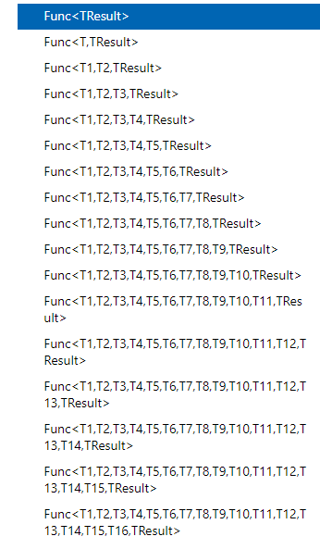
Func – generic delegate
There are 16 variations for the Func<> delegates - https://docs.microsoft.com/en-us/dotnet/api/system.func-1?view=netframework-4.7.2
In .NET 4.7.2:
public delegate TResult Func<TResult>()
public delegate TResult Func<T, TResult>(T arg)
public delegate TResult Func<T1, T2, TResult>(T1 arg1, T2 arg2)
public delegate TResult Func<T1, T2, T3, TResult>(T1 arg1, T2 arg2, T3 arg3)
public delegate TResult Func<T1, T2, T3, T4, TResult>(T1 arg1, T2 arg2, T3 arg3, T4 arg4)
…

Slide 4
Func - delegates
Demo

Slide 5
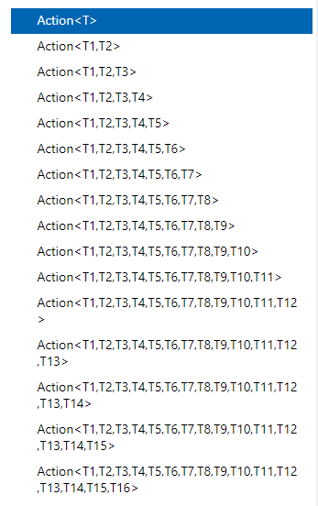
Action – generic delegate
The Action delegates also has 16 variations - https://docs.microsoft.com/en-us/dotnet/api/system.action-1?view=netframework-4.7.2
In .NET 4.7.2:
public delegate void Action()
public delegate void Action<T, >(T arg)
public delegate void Action<T1, T2>(T1 arg1, T2 arg2)
public delegate void Action<T1, T2, T3>(T1 arg1, T2 arg2, T3 arg3)
public delegate void Action<T1, T2, T3, T4>(T1 arg1, T2 arg2, T3 arg3, T4 arg4)
…

Slide 6
Action - delegate
Demo

Slide 7
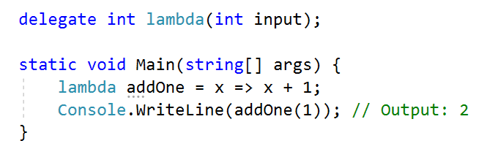
Lambda expressions
Identifiable syntax for lambda:
(params) => expression
Examples:
x => x+1;

Slide 8
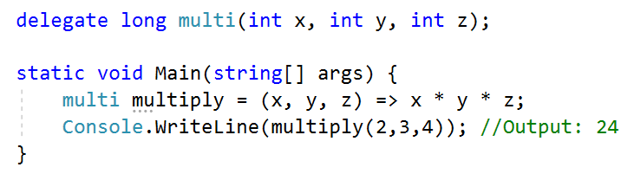
Lambda expressions
Using multiple parameters

Slide 9
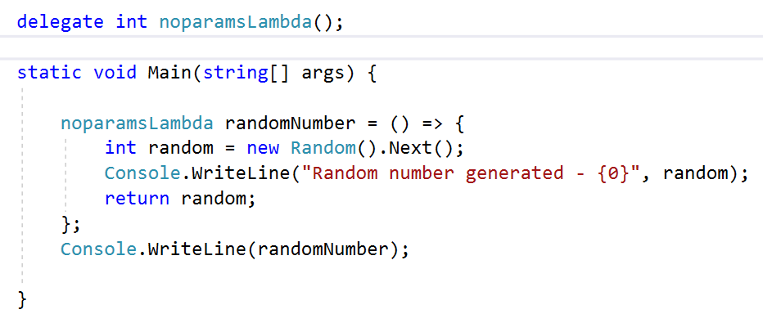
Lambda expressions
No parameters, statement lambdas
Example:

Slide 10
Lambda expressions
Exercising

Slide 11
LINQ
Language Integrated Query – LINQ
LINQ Architecture
Benefits of using LINQ
LINQ Providers

Slide 12
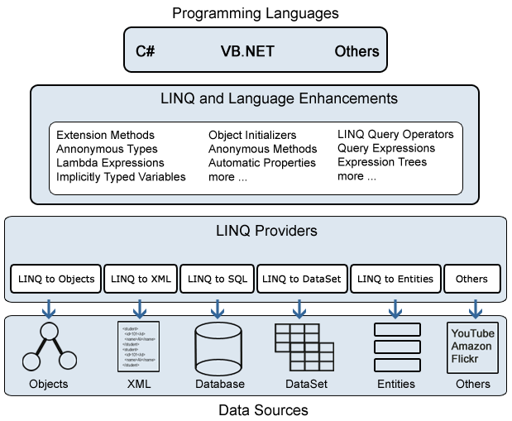
LINQ

Slide 13
LINQ
LINQ enables us to work with different data structures (array generic objects, XML, SQL Server, data sets,…) using similar coding style. You don’t need to know the specific technology syntax for querying the data structures.
LINQ is supported with the VS intelli-sense.
C#, Visual Basic, F#
LINQ providers – components between the LINQ query and data sources:
LINQ to Objects
LINQ to XML
LINQ to SQL
LINQ to Entities
LINQ to DataSets
LINQ to Others (Twitter, Amazon, Google, … )
For example, LINQ to SQL converts a LINQ query to T-SQL query.

Slide 14
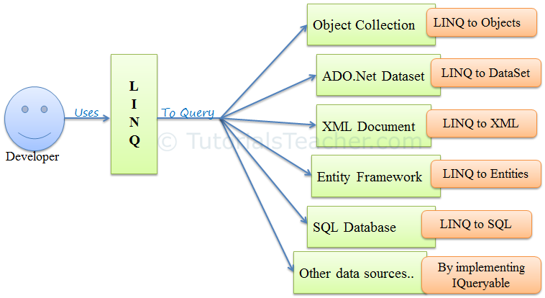
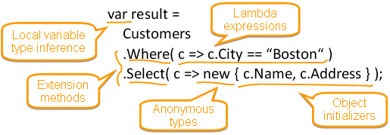
LINQ

Slide 15
LINQ Queries
LINQ Queries can be:
1. Lambda expressions
2. SQL-like query expressions
There is no difference between the two when performance is in question.
LINQ queries written with SQL-like style are translated into their lambda expressions before they are compiled (behind the scene).
The standard query operators are implemented as extension methods on IEnumerable<T> interface. Most of the generics (List<T>, Dictionary<T>, …) implement IEnumerable<T> so that extension methods can be used with them.
Some standard query operators:
Select
From
Where
OrderBy
…

